Slide 1
The Northern Ireland peace process
Taking a look at history and current issues

Slide 2
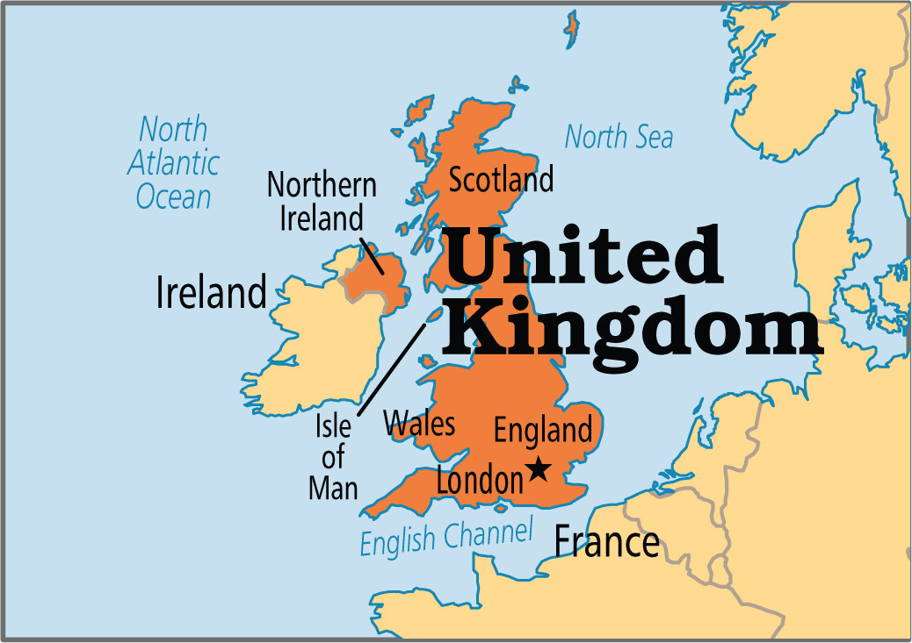
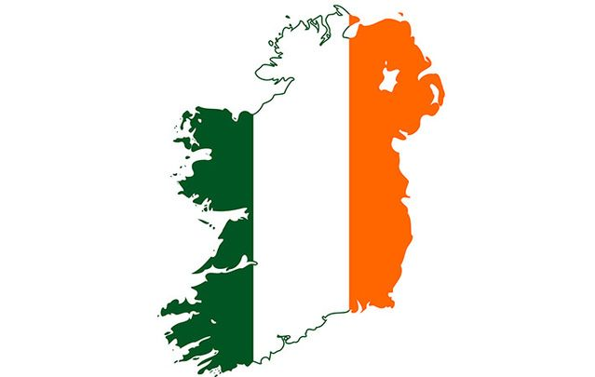

The Northern Ireland conflict
Northern Ireland with united kingdom
Reunification of northern Ireland and Ireland
Notes:
The conflict in the Northern Ireland is simply between the people who Northern Ireland as part of the United Kingdom against those who wish to reunify Northern Ireland and the Republic of Ireland in the south. The conflict’s root dates back to the introduction of Protestant Colonists who took over the lands of Native Irish and occupied approximately 95% of Northern Ireland.

Slide 3
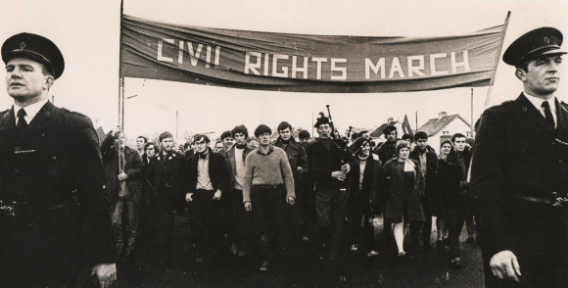
What started the conflict?
  Alleged Discrimination
Notes:
The conflict started with more than just the occupation of the Protestant Colonists. During the occupation of the Protestant colonists, it is alleged that the protestants were oppressing and discriminating the Native Irish people. Not able to further stand the oppression and discrimination from the Protestants, violent rebellions were started by the Catholic people.

Slide 4
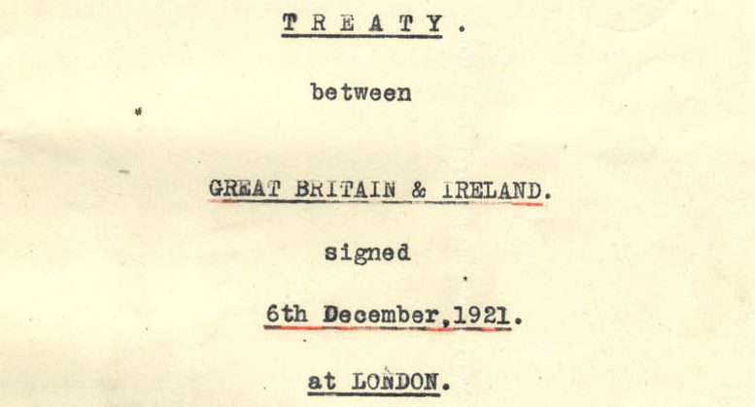
What Caused The Separation?
Anglo-Irish Treaty of 1921
Notes:
An attempt to solve the conflict between the Catholics and the Protestants led to the signing of the Anglo-Irish Treaty of 1921. In this treaty, Ireland became partitioned into two sections: The Northern Ireland composed of 6 predominantly Protestant counties and The Republic of Ireland composed of 26 mainly Catholic counties. However, even with the partition of Ireland, conflict continued to exist between the two regions and violence continued to arise during the 20th century. One of the most long-standing was the era of “The Troubles” from 1960s to 1990s where Civil Rights Campaigns done by the Catholics.

Slide 5
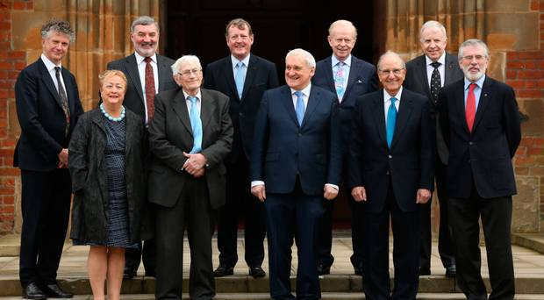
Solving the Conflict
The Good Friday Agreement
Notes:
The Good Friday Agreement or the Belfast Agreement is considered to be the culmination of splintered peace talks that have been going on for decades. It is a compromise between the Nationalist and Unionist parties. It was agreed to by 71% of Northern Ireland’s population and 94% of the Republic of Ireland’s population. In this agreement, it is stated that a power-sharing institution would be put in place. Moreover, this agreement also seeks to address concerns ranging from decommissioning and devolution up to the issues of criminal justice and policing reforms.

Slide 6
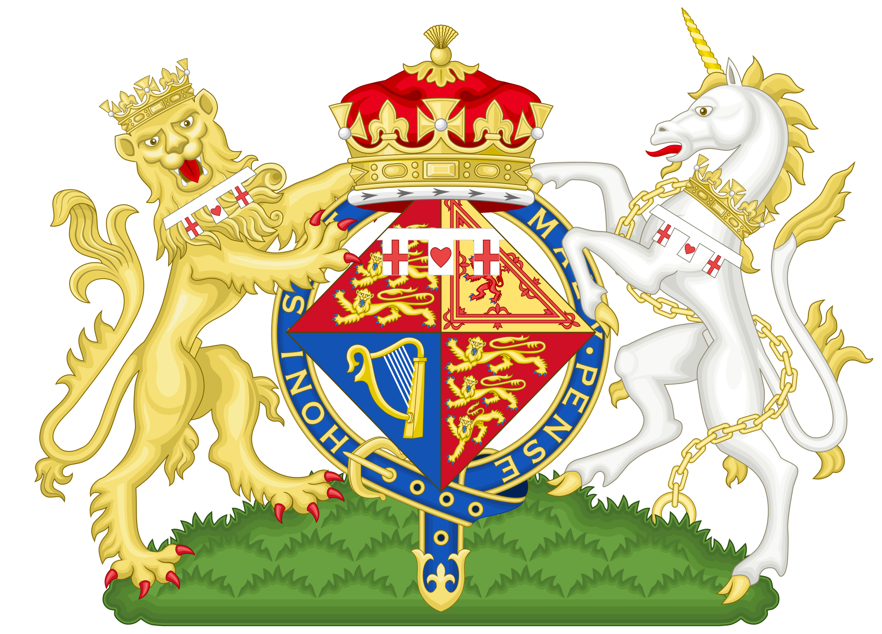
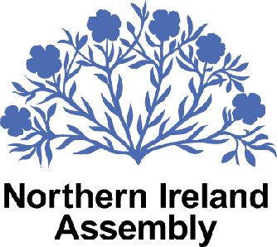
The Governing Structure of Northern Ireland
The UK Government
Northern Ireland Assembly
Notes:
Under the Good Friday Agreement, it was also established that governance of Northern Ireland would be held under two branches: The Northern Ireland Assembly and the United Kingdom Government.
The UK Government overlooking Northern Ireland is a cabinet-like executive and administers most of the governing. It is headed by the First Minister along with the Deputy Minister with the First Minister usually belonging to the Unionist Party and the Deputy First Minister coming from the Nationalist Party. They are the ones who make new laws and set taxes.
The Northern Ireland Assembly, on the other hand, is considered to be the cornerstone of the Northern Ireland government where political representatives debate about laws and other concerns relevant to Northern Ireland. It is composed of 90 representatives called the Members of the Legislative Assembly or MLA. The Assembly is the one responsible for legislating on matters like health, education, agriculture, and trade.

Slide 7
Taking a Look at the Implementation of The Good Friday Agreement
Successes and Failures
Notes:
A lot of discussions have been made to decide whether the implementation of the Good Friday Agreement was a success. However, looking at it at large, it can be said that the implementation of the Agreement both had its successes and downfalls. We will be discussing these points in the following slides.

Slide 8
Taking a Look at the Successes and Failures of The Good Friday Agreement
The Principle of Consent
The Northern Ireland Assembly and Executive
Inclusion of Third Parties helped foster coordination
REDUCED VIOLENCE AND POLICING REFORM
Notes:
One of the major positive impacts of the implementation of the agreement is the creation of the principle of consent. Here, Northern Ireland was given the opportunity to decide which state it belonged to. The Republicans also voted to change the constitutional status of Northern Ireland which was one of the main causes of the conflicts and revolts.
Another is that with the implementation of the Good Friday Agreement, the people of Northern Ireland at last felt that their voices were being heard at last because they already had their own representatives and governing bodies through the Northern Ireland Assembly and Executive. This, according to studies, has been one of the major factors in the continuation of the peace process.
Next is the inclusion of the third parties in the negotiations of the peace process. According to a study, the inclusion of third parties helped the Nationalists and Unionists to pull on the same direction and to foster coordination. What’s more is that these third parties paved the way to provide economic incentives to Northern Ireland. With this in view, this reduced the existence of paramilitary groups which draws from the poor who had no real options regarding these matters.
Finally, there was a significant decrease in violence when the agreement was signed by the parties. The agreement was the way in which the paramilitary groups agreed to surrender their weapons and enter a more democratic and civilized peace process. The statistics show that the conflict-related death tolls of 480 in 1972 dropped to a single digit in the recent years.

Slide 9
Taking a Look at the Successes and Failures of The Good Friday Agreement
A series of Assembly suspensions
  FAILURES IN DECOMMISSIONING AND SPOILERS
The need for cross-community majority
Third parties: Added work
The replacement of combatants into society
Notes:
Unfortunately, the Good Friday Agreement was not all successful. The agreement also faced a series of setbacks and downfalls due to various factors. The first of the failures seen on the Good Friday Agreement is the series of Assembly suspensions during the 20th and 21st century. These suspensions painted a negative impression on the Agreement and also creates a negative picture regarding the security of Northern Ireland. These suspensions are mainly caused by the failure of the Assembly to ultimately disarm the IRA.
Another failure in the agreement is shown in the need for cross-community majority. The cross-community majority concept tells that the concerned needs to reach an agreement. However, even as shown in the past relationship of the parties, disagreements continued to ensue, especially on larger and more significant issues.
A next concern, while also stated as a success, was the concerns raised due to the inclusion of the third parties. Instead of aiding in the conflicts between the major parties, the third parties added to the concerns that needs to be addressed. This is due to the fact that they constantly complained to the British for their own benefits.
Finally, another failure that was observed in the agreement was its failure to address the replacement of combatants into society. It is stated that it is essential that these combatants do not feel marginalized and left out of the new society being created so that they may not come back to resorting violence. If this is not addressed, it would only become a cycle of violence because they would not feel that they are not contributing to society again even after the peace process.

Slide 10

Northern Ireland Government: A Current Look
Political Stability in Belfast unraveled in 2017

Slide 11
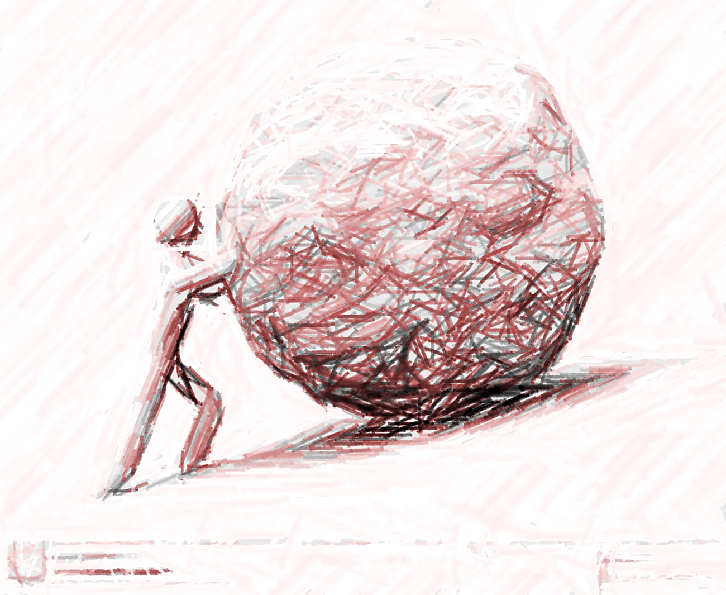
Challenges in the Northern Ireland Peace Process
Language and Culture
Parades and Marches
Prosecuting those responsible for killings
Development of comprehensive approach in solving violence
Notes:
While there are already identified successes and failures, there are still outstanding challenges that the agreement needs to address. This includes disagreements in language and culture, undertones from parades and marches of members of different parties, the prosecution of killers during the various violent incidents, and the development of a comprehensive approach in solving violence.
As for language and culture, disagreements are existing in which language to use: Irish or Scottish. The reason is that these two parties spoke a separate language from each other during the span of conflict in Ireland. As for parades and marches, it has been identified that these activities by some of the members of each group still held sectarian undertones which needs to be eliminated or prevented as much as possible so that future conflicts may be stopped.
In terms of the prosecution and the development of comprehensive approach to violence, the concerned major parties has yet to reach a consensus but there are a lot of proposals being submitted. One of the proposals included the establishment of a historical investigation unit that would be responsible for overseeing unsolved deaths during the span of the conflict.

Slide 12
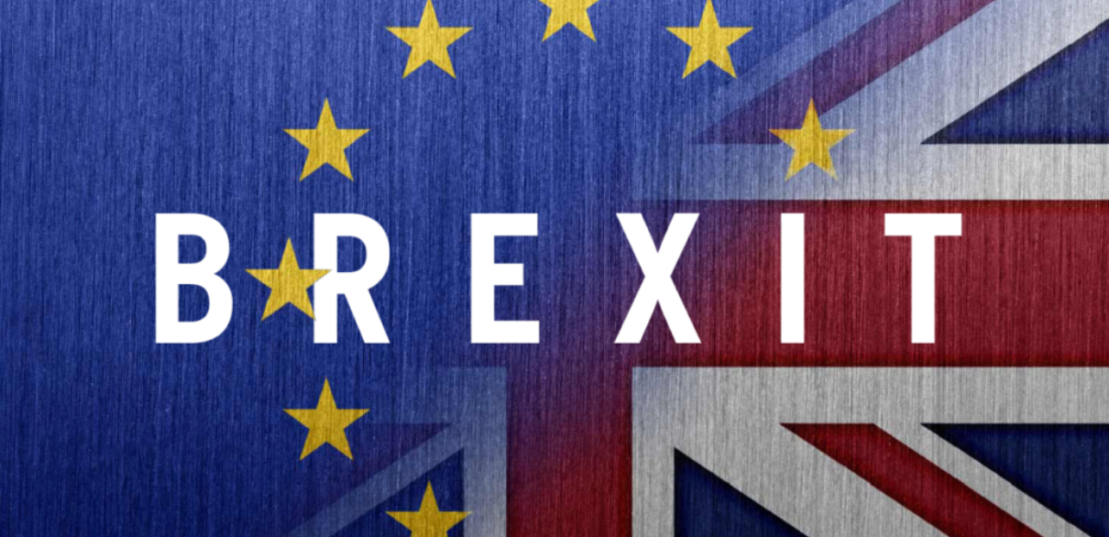
Taking a Look at the Impact of Brexit
56% of the northerners voted for the UK to remain in the EU.
DUP alone among northerners in supporting Brexit.
Blair and Varadkar: “Brexit threatens peace process”
Notes:
Finally, the removal of the United Kingdom from the European Union has been a hot debate and major concern in relation with the Northern Ireland Peace Process. With the possibility of removing itself from the European Union, Blair and Varadkar, holds an agreement that Brexit could possibly threaten the peace process that they have been working on for years.
The reason is that the Good Friday Agreement involves various parties that may be affected by the exit. The agreement holds on three strands including the institutions governing Northern Ireland, the North-South cooperation between Northern Ireland and the Republic of Ireland, and the East-West cooperation between the leaders from UK and Ireland. Political leaders and analysts worry that the disruption in any of these strands caused by the Brexit might possibly undermine the hard-earned trust formed in this peace process.

Slide 13
A Timeline of the
Northern Ireland Peace Process
18th Century
20th Century
20th Century
20th Century
20th Century
The Protestants
Treaty Of 1921
Periods of Significant Violence
1960s to 90s: The Troubles
1972
Occupied 95% of North of Ireland
Oppressed Native Irish communities
Parted Ireland into two sections:
  6 predominantly protestant counties (North)
  26 mainly catholic counties (South)
1920s, 1940s, 1950s: Catholic Nationalists of the South attempted a forced reunification
Most sustained period of violence
Catholics’ claims of discrimination by Protestants resulted to civil rights campaign
Stormont Government (ruling gov’t of north of Ireland)
North of Ireland became directly ruled from London
Notes:
The following slides present the key events in the Northern Ireland Peace process starting from the origin of conflict.

Slide 14
A Timeline of the
Northern Ireland Peace Process
20th Century
20th Century
20th – 21st Century
21st Century
21st Century
1998: The Good Friday Agreement
1999
Y2K-2K3 Suspensions
2004
2005
Northern Ireland Assembly was created
Protestant Unionist David Trimble becomes First Minister, resigns 2001 but reelected again
Direct rule of Westminster on Northern Ireland ends after 25 years
Caused by the anger of Unionists for the lack of progress in IRA disarmament
Attempts to end impasse
IRA rejects DUP demands to take pictures of IRA getting rid of weapons
IRA blamed for massive bank raid on December 2004
IRA tells units to give up weapons and formally ends armed campaign

Slide 15
A Timeline of the
Northern Ireland Peace Process
21st Century
21st Century
21st Century
21st Century
21st Century
2006
2007
2009
2011 & 2014
2015
Protestant Michael Stone interrupts Northern Ireland Assembly by entering building with a handgun, a knife, and a “viable” bomb
Democratic Unionist Party enters historic power-sharing government with Sinn Fein
Nationalist paramilitaries shoot down British soldiers near their barracks at Antrim
The Queen visits Ireland on 2011 for the first time since 1911;
Invites Martin McGuinness to Windsor Castle in 2014
Six Irish Republicans arrested for having bomb-making equipment near the location the Prince of Wales and Duchess of Cornwall are scheduled to visit

Slide 16
Question for discussion
If the United Kingdom does find itself removed from the European Union, Would it be possible to sustain the cooperation between the three strands of The Good Friday Agreement?
If so, what can the signees of The Good Friday Agreement do to sustain the cooperation between its three strands?

Slide 17
References
Cairns, E., & Darby, J. (1998). The conflict in Northern Ireland: Causes, consequences, and controls. American Psychologist 53(7), pp. 754-760.
Debraggio, J.M. (2010). Implementing the Good Friday Agreement: Overcoming challenges and obstacles. Retrieved from https://digitalcommons.bucknell.edu/cgi/viewcontent.cgi?article=1024&context=honors_theses.
Democratic Progress Institute. (2013). The Good Friday Agreement – An overview. Retrieved from http://www.democraticprogress.org/wp-content/uploads/2013/07/The-Good-Friday-Agreement-An-Overview.pdf.
Landow, C., & Sergie, M.A. (2018). The Northern Ireland peace process. Council on Foreign Relations. Retrieved from https://www.cfr.org/backgrounder/northern-ireland-peace-process.
Northern Ireland Direct. (n.d.). Overview of government in Northern Ireland. Retrieved from https://www.nidirect.gov.uk/articles/overview-government-northern-ireland.
“Northern Ireland Peace Process Timeline.” (2005). The Telegraph. Retrieved from https://www.telegraph.co.uk/news/1499247/Northern-Ireland-peace-process-timeline.html.
Rowley, T. (2015). Timeline of Northern Ireland troubles: From conflict to peace process. The Telegraph. Retrieved from https://www.telegraph.co.uk/news/uknews/northernireland/11610345/Timeline-of-Northern-Ireland-Troubles-from-conflict-to-peace-process.html.

